Slide 1
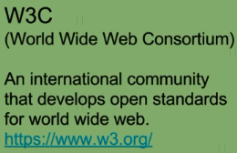
What are SOAP Web Services?

Slide 2
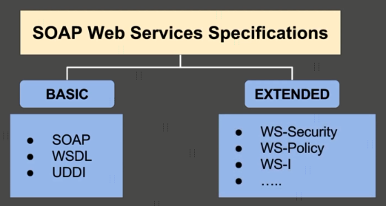
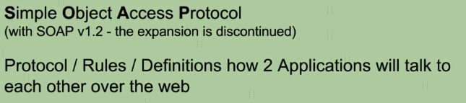
What are SOAP Web Services?

Slide 3



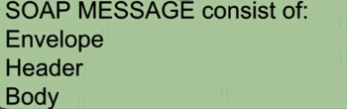
What are SOAP Web Services?
Request
Client
(Service Consumer)
Server
(Service Provider)
Response

Slide 4
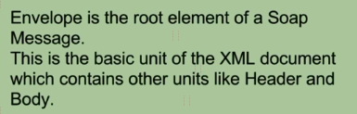
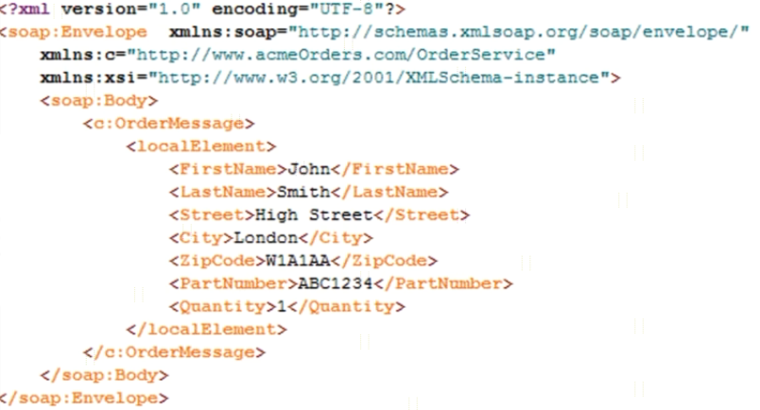
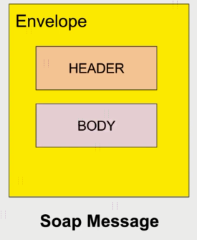
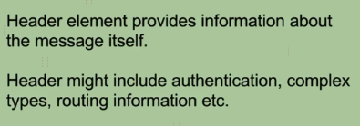

What are SOAP Web Services?

Slide 5
What is a Web Service?
https://www.udemy.com/course/web-services-api-step-by-step-beginner-tutorial/learn/lecture/10047722#overview

